Slide 1
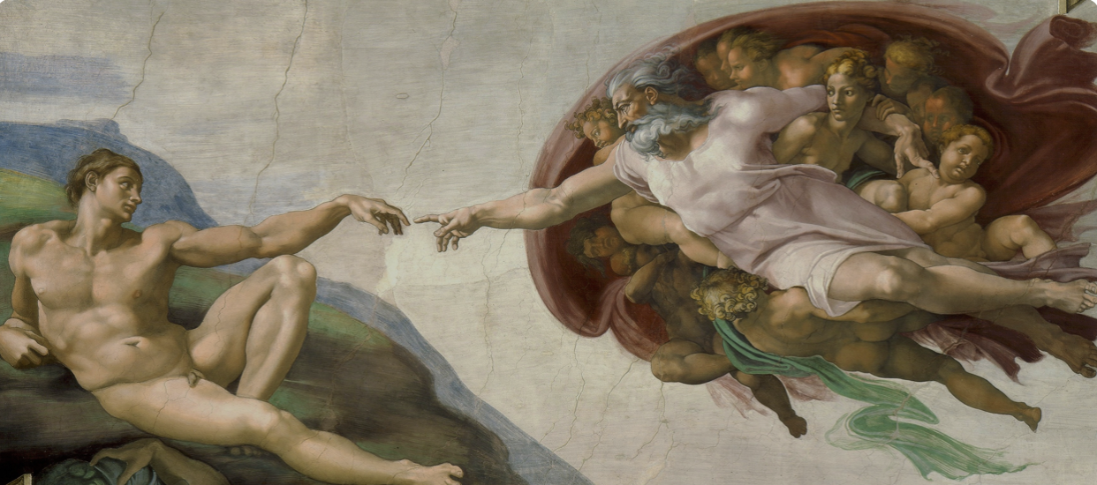
Theology of the Body A Catechesis on Human Love

Slide 3
“As a young priest I learned to love human love. This has been one of the fundamental themes of my priesthood…If one loves human love, there naturally arises the need to commit oneself completely to the service of “fair love”, because love is fair, it is beautiful.”
John Paul II
Crossing The Threshold of Hope

Slide 5
1960

Slide 7
Pontifical Commission on Birth Control 1963 - 1966

Slide 8
Majority Report:
”It is natural to man to use his skill in order to put under human control what is given by physical nature.”
“The duty of man to humanize and to bring to greater perfection for the life of man what is given in nature.”
”Fecundity in the totality of married life [which] does not depend upon the direct fecundity of each and every particular act.”

Slide 9
Majority Report:
”It is natural to man to use his skill in order to put under human control what is given by physical nature.”
Man does not have unlimited control over the laws of nature. Technical mastery over nature must always be ordered and subordinated to the authentic good of the human person.
“The duty of man to humanize and to bring to greater perfection for the life of man what is given in nature.”
One must respect the laws of nature that are intrinsically ordered to certain goods: the unitive and the procreative dimension of the conjugal act must be respected for the good of conjugal love and the dignity of the spouses.
”Fecundity in the totality of married life [which] does not depend upon the direct fecundity of each and every particular act.”
Each and every conjugal act must remain open to life.

Slide 10
Paul VI’s Prophetic Words: Conjugal Infidelity General lowering of morality Loss of respect for women Abuse of power Disposition of unlimited dominion over one’s body

Slide 11
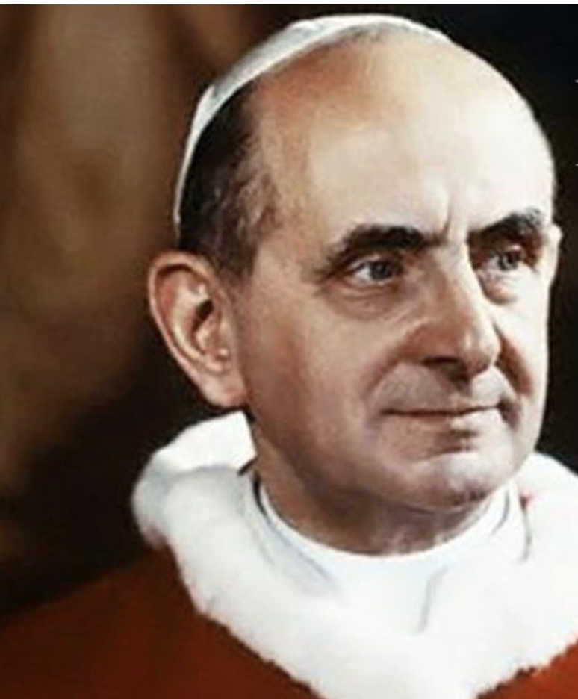
Pope Paul VI’s Prophetic Words:
Conjugal infidelity
General lowering of morality
Loss of respect for women
Abuse of power
Disposition of unlimited dominion over one’s body

Slide 12
16 October 1978

Slide 13
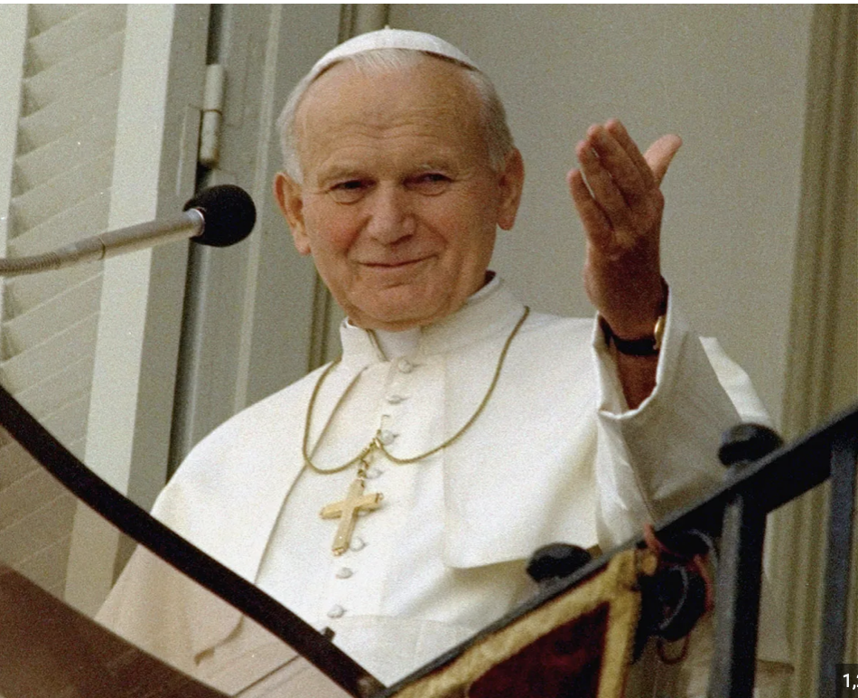

Slide 14
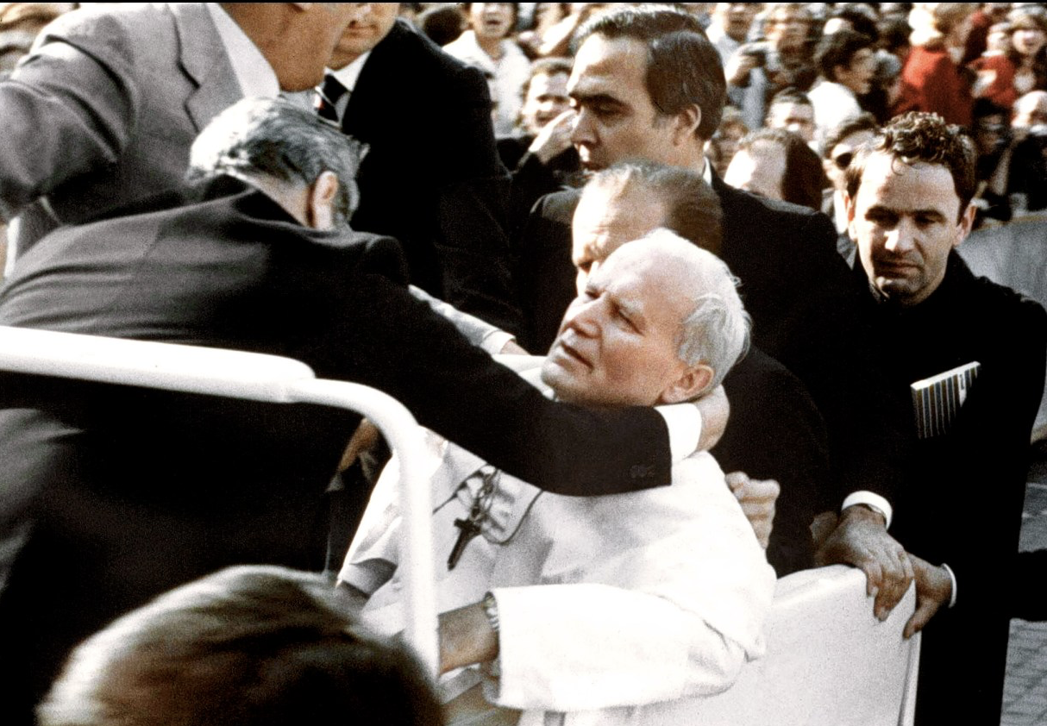
13 May 1981

Slide 15
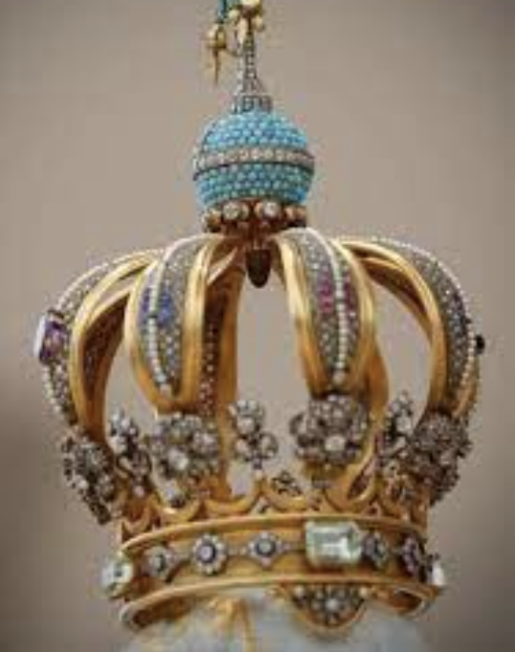
”One hand pulled the trigger,
another guided the bullet”
John Paul II

Slide 16
During the first five years of his pontificate:
The Theology of the Body
Synod on the Family
Pontifical Council for the Family
Familiaris Consortio
The Pontifical Institute for Studies on Marriage and the Family
Charter of the Rights of the Family
New ordering of marriage law in the 1983 Code of Canon Law

Slide 17
“Family, become what you are!”

Slide 18
Laying the foundations
The Personalistic Norm
John Paul II’s use of phenomenology
Understanding contemporary man

Slide 19
The Personalistic Norm:
“The person is the kind of good which does not admit of use and cannot be treated as an object of use and as such the means to an end. In its positive form the personalistic norm confirms this: the person is a good towards which the only proper and adequate attitude is love.”
Love and Responsibility, pg. 41

Slide 20
“An objective common good is the foundation of love.”
Love and Responsibility, pg.38

Slide 21
Utilitarianism:
“Utilitarianism puts the emphasis on the usefulness (or otherwise) of any and every human activity. The useful is whatever gives pleasure and excludes its opposite, for pleasure is the essential ingredient of human happiness.”
Love and Responsibility, pg. 35

Slide 22
Gaudium et Spes #24:3
“Man, who is the only creature on earth which God willed for itself,
cannot fully find himself except through a sincere gift of himself.”

Slide 23
The opposite of LOVE is USE
“Utilitarianism is a civilization of production and of use, a civilization of “things” and not of “persons,” a civilization in which persons are used in the same way as things are used. In the context of a civilization of use, woman can become an object for man, children a hindrance to parents, the family an institution obstructing the freedom of its members.”
Letter to Families, #13

Slide 24
John Paul II’s use of Phenomenology
Phenomenology:
A philosophical approach that focuses on the study of human experience in order to arrive at knowledge.
For John Paul II:
It is essential to find subjective confirmation of objective truths. We find this by means of experience.

Slide 25
OBJECTIVE TRUTH
SUBJECTIVE EXPERIENCE

Slide 26
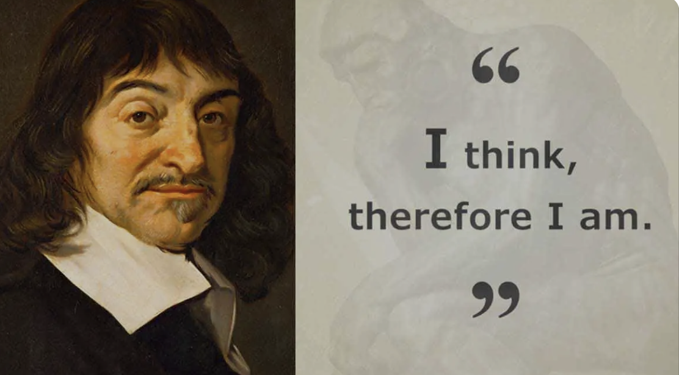
Understanding Contemporary Man
The motto of modern rationalism:

Slide 27
Philosophy of Existence:
Existence determines thought
(St Thomas Aquinas)
God the Creator is at the centre of reality (philosophy of existence)
Creation is given, we receive and discover it (resulting in awe and respect)
Self-realisation
Philosophy of Consciousness:
Thought determines existence (Rene Descartes)
Man is at the centre of reality (anthropocentric shift in philosophy)
Creation is what man ascribes to it (tends towards control and domination)
Self-creation

Slide 28
Unfolding of Modern Rationalism

Slide 29
“I think, therefore I am.”
My essence is found in my thought
My body is simply matter
Separation of
body and soul

Slide 30
My body is simply matter = materialism
So I can do what I want with it = utilitarianism

Slide 31
Because my body is an object, I can:

Slide 32
Because my body is an object, I can:
Prostitution / hook up culture
IVF
Contraception / sterilization
Pornography
Abortion
Sex change

Slide 34
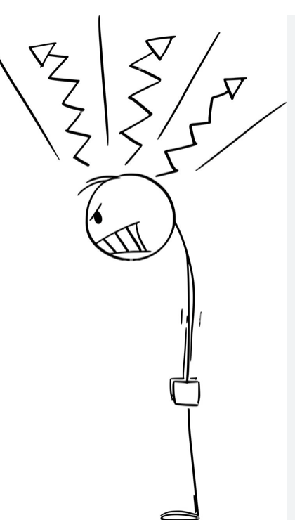
WHO AM I?
(consequences of the culture of death)
Anger
Self-harm
Anxiety
Suicide
Depression

Slide 35
Meat Skeleton

Slide 36
“Christ reveals man to himself…This statement is the reply which the Church has given to modern rationalism… The separation of spirit and body in man has led to a growing tendency to consider the human body, not in accordance with the categories of its specific likeness to God, but rather on the basis of it’s similarity to all the other bodies present in the world of nature, bodies which man uses as raw material in his efforts to produce good for consumption… When the human body, considered apart from spirit and thought, comes to be used as raw material in the same way that the bodies of animals are used…we will inevitably arrive at a dreadful ethical defeat.”
Letter to Families, #19

Slide 37
Original Man Christ Appeals to the Beginning

Slide 38
Jan van Doornik, c. 1525.

Slide 39
ORIGINAL MAN
HISTORICAL MAN
ESCHATOLOGICAL MAN

Slide 40
Why does Christ point us back to the beginning?
To regain what has been lost.
How do we regain what has been lost?
Redemption = Redimere (Latin) = to regain, to buy back

Slide 41
Fill in the blank….
Original _______

Slide 42
Fill in the blank….
Original __Sin___

Slide 43
The Three Original Experiences:
Original Solitude
Original Unity
Original Nakedness

Slide 44
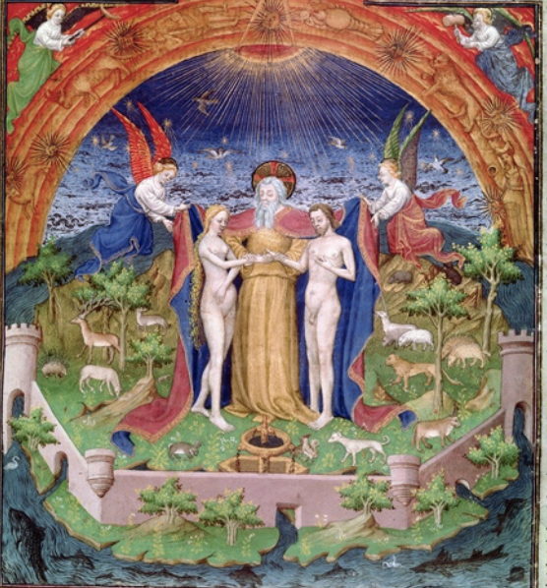
The First Creation Account
“Then God said: ‘Let us make man in our image, after our likeness.’… So God created man in his own image; in the image of God he created him; male and female he created them. And God blessed them, and God said to them, ‘Be fruitful and multiply, and fill the earth and subdue it…’”
Genesis 1:26-28

Slide 45
Created in the Image and Likeness of God
Created Male and Female
Called to be Fruitful and Multiply
”God saw everything that he had made, and indeed it was very good” Genesis 1:31

Slide 46
Second Creation Account
Subjective in nature
Adam and Eve’s subjective experiences correspond to the objective reality designed by God
Objective moral norms stem from the inner truth of who we are

Slide 47
Original Solitude

Slide 48
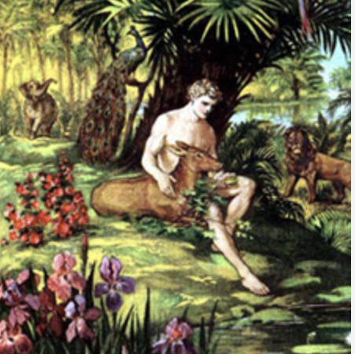
Original Solitude
Who Am I?

Slide 49
Original Solitude Who Am I?
I am a body-person:
I have intellect and will to know and love God and I express this through my body.
I have inalienable dignity:
I am the only creature on earth which God has willed for itself
I am unique and unrepeatable:
My relationship with God is exclusive and intimate. I stand alone before God.
I am utterly dependent upon God
I am master of my destiny: death or immortality

Slide 50
Original Solitude
Who Am I?
I am a child of God!
(Divine Filiation)

Slide 51
Reflection Questions:
Can I recognise the experience of Original Solitude in my life?
The solitude that points to my relationship with God. Where do I experience this solitude? (prayer, interior struggle, encounter with beauty)
The solitude derived from relationships (desire for friendship, companionship)
Solitude from sin (alienation, self-isolation, sadness)

Slide 52
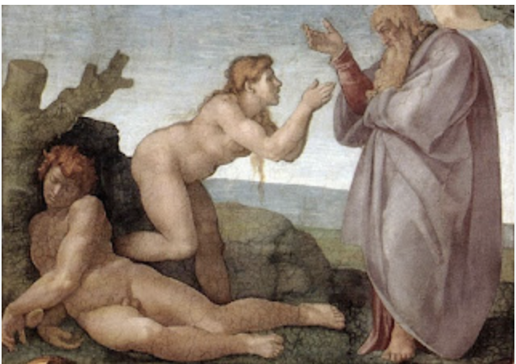
Original Unity

Slide 53
“So the Lord God cause a deep sleep to fall upon the man, and while he slept took one of his ribs and closed up its place with flesh; and the rib which the Lord God had taken from the man he made into a woman and brought her to the man. Then the man said, ‘This at last is bone of my bone and flesh of my flesh; she shall be called Woman, because she was taken out of Man’.”
(Genesis 2:21-23)

Slide 54
Communion of Man and Woman as Image of the Trinity
“Man became the image of God not only through his own humanity, but also through the communion of persons, which man and woman form from the very beginning.” (TOB 9:3)

Slide 55
The “Incarnate Communion of Persons”
“The unity that is realized through the body indicates from the beginning not only the “body,” but also the “incarnate” communion of persons – communio personarum – and requires this communion right from the beginning.” (TOB 9:5)
“In marriage, the physical intimacy of spouses becomes a sign and pledge of spiritual communion.” (CCC, 2360)

Slide 56
Just as the body expresses the person, the one flesh union must express a true communion of persons

Slide 57
Original Unity
“Therefore a man leaves his father and his mother and cleaves to his wife, and they become one flesh.” (Gen 2:24)
The human person has not been created to be alone
Our very essence is relational
We are called to a communion of persons
Masculinity and femininity express this call to communion
The one flesh union is the “incarnation of the communion of persons”

Slide 58
John Paul II’s Thesis Statement
“The body, and it alone, is capable of making visible what is invisible, the spiritual and divine. It was created to transfer into the visible reality of the world, the invisible mystery hidden in God from time immemorial, and thus to be a sign of it” (TOB 19:4)
Primordial Sacrament:
Marriage is the original revelation of God’s mystery in the created world.

Slide 59
Original Unity
What is the meaning of my existence?
To love and to be loved
(Communion of Persons)

Slide 60
Original Nakedness

Slide 61
“Now both were naked, the man and his wife, but they did not feel shame.” (Gen 2:25)

Slide 62
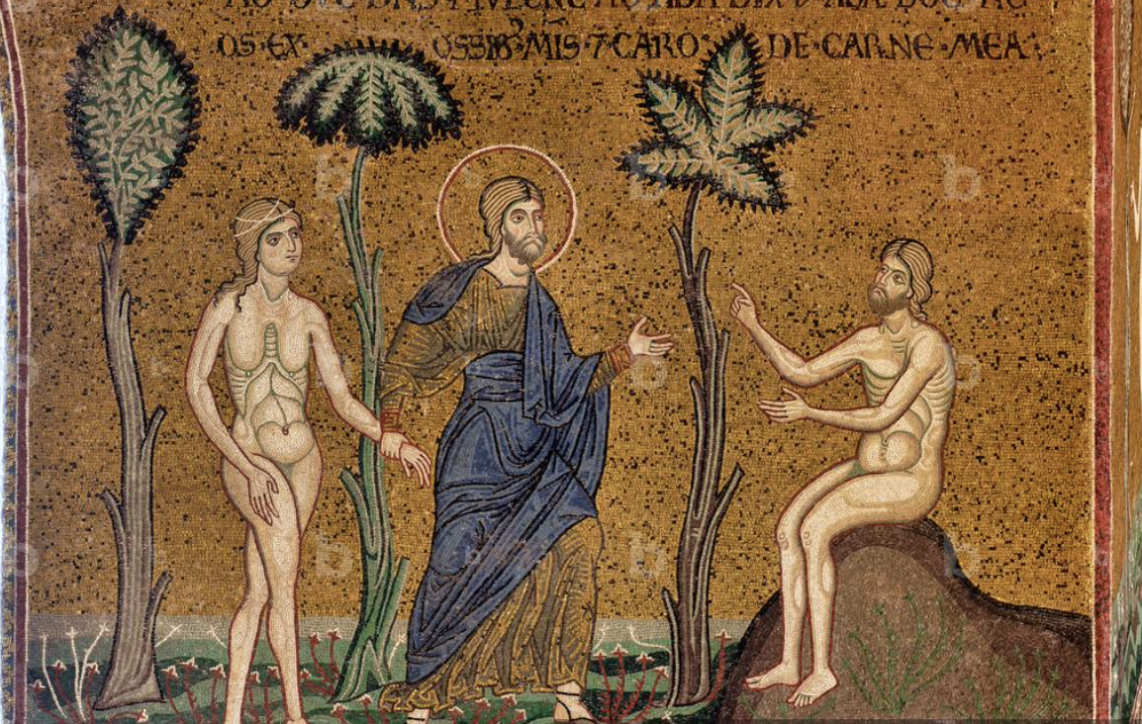
Nakedness signifies the original good of the divine vision.” (TOB 13:1)
“God saw everything that he had made, and indeed, it was very good.” (Gen 1:31)

Slide 63
“To this fullness of “exterior” perception, expressed by physical nakedness, corresponds the “interior” fullness of the vision of man in God, that is, according to the measure of the ‘image of God’.”
(TOB 12:2)

Slide 64
The “peace of the interior gaze”
The first man and woman “see each other more fully and clearly than through the sense of sight itself.” (TOB 13:1)

Slide 65
The Dimension of Gift

Slide 66
The spousal meaning of the body
”The human body, with its sex – its masculinity and femininity – seen in the very mystery of creation, is not only a source of fruitfulness and of procreation, as in the whole natural order, but contains “from the beginning” the “spousal” attribute, that is the power to express love: precisely that love in which the human person becomes a gift and – through this gift – fulfills the very meaning of his being and existence.” (TOB 15:1)

Slide 67
The Meaning of the Body:
The body expresses the person
The body expresses a masculine person or a feminine person
The body expresses the inner dimension of the gift

Slide 68
“The human body, oriented from within by the “sincere gift” of the person, reveals not only its masculinity or femininity on the physical level, but reveals also such a value and such a beauty that is goes beyond the simple physical level of “sexuality”. (TOB 15:3)

Slide 69
Original Happiness
“The revelation and discovery of the spousal meaning of the body explain man’s original happiness and, at the same time, they open the perspective of his own earthly history, in which he will never withdraw from this indispensable “theme” of his own existence.” (TOB 15:5)

Slide 70
“Man cannot live without love. He remains a being that is incomprehensible for himself, his life is senseless, if love is not revealed to him, if he does not encounter love, if he does not experience it and make it his own, if he does not participate intimately in it.”
(Redemptor Hominis, #10)

Slide 71
”Adam knew Eve his wife, and she conceived and bore Cain, saying, ‘I have gotten a man with the help of the Lord.” (Genesis 4:1)

Slide 72
The Meaning of the Body:
The body expresses the person
The body expresses a masculine person or a feminine person
The body expresses the inner dimension of the gift
Fatherhood and motherhood

Slide 73
“The eternal mystery of generation, which is in God himself, the one and Triune God (cf Eph 3:14-15), is reflected in the woman’s motherhood and in the man’s fatherhood.”
(Mulieris Dignitatem, n.18)

Slide 74
In “Genesis 4:1 the mystery of femininity manifests and reveals itself in its full depth through motherhood…Woman stands before the man as mother, subject of the new human life that is conceived and develops in her and is born from her into the world. In this way, what also reveals itself is the mystery of the man’s masculinity, that is, the generative and ‘paternal’ meaning of his body.” (TOB 21:2)

Slide 75
“You will return to the earth, for out of it you were taken; dust you are, and to dust you shall return” (Genesis 3:19)

Slide 76
Historical Man Christ Appeals to the Human Heart

Slide 77
Its not about the nail

Slide 78
Ethics and Ethos
Ethics = a set of moral principles that govern a person’s behaviour. It is concerned with establishing what is right and wrong.
Ethos = refers to the “interior perception of values”. It is a person’s subjective world of values.

Slide 79
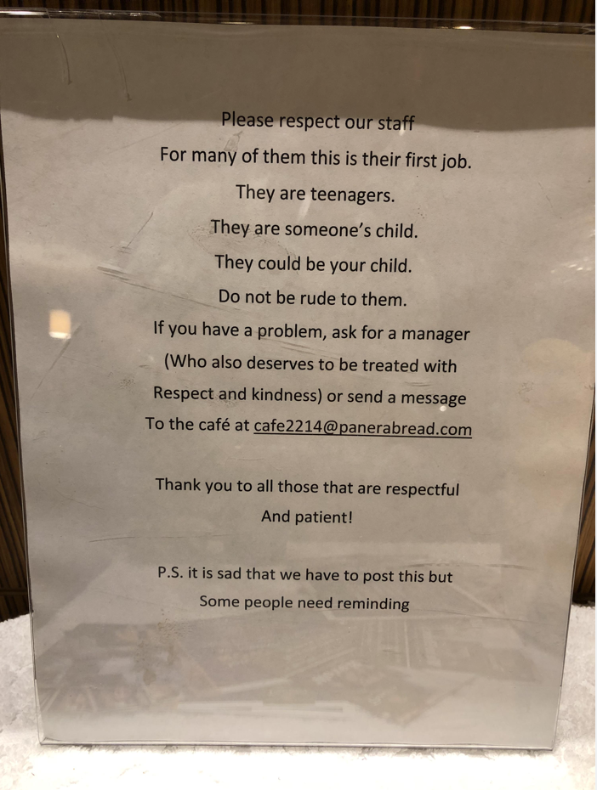
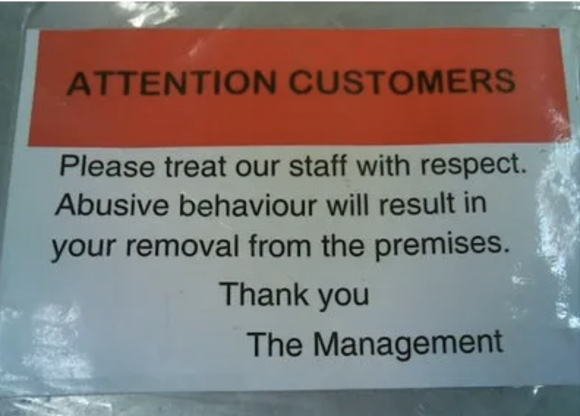

Slide 80
Purity as “Life According to the Spirit”

Slide 81
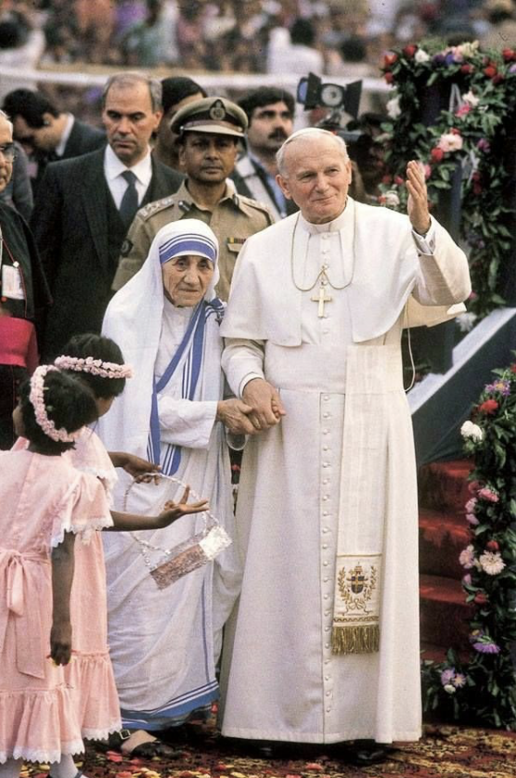
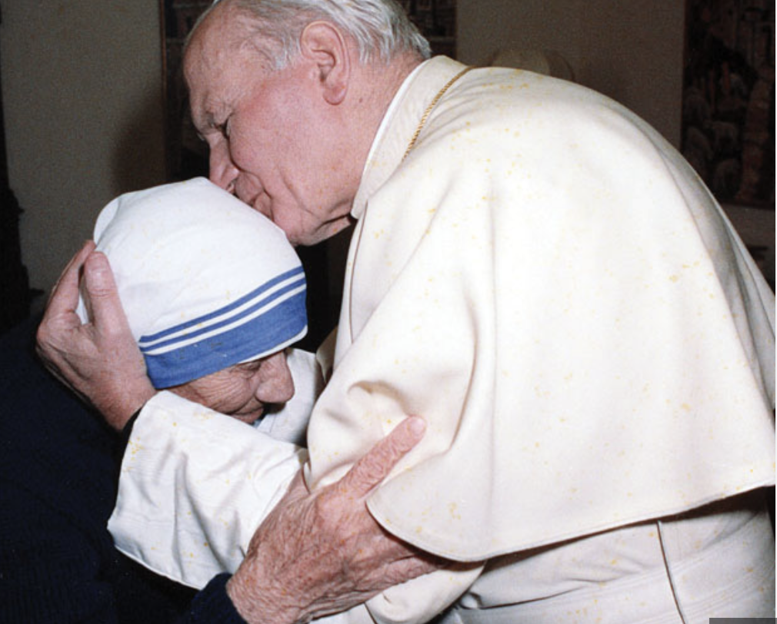

Slide 82
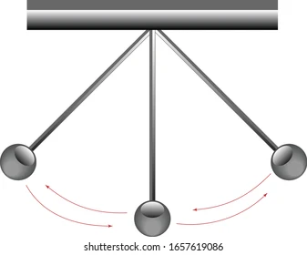
Puritanism
Licentiousness
Repression
Permissiveness
Stoicism
Indulgence
Pessimism
Addiction
Scruples
Integrity
Freedom
Redemption
Shamelessness
Guilt complex

Slide 83
Eschatological Man Christ Appeals to the Resurrection

Slide 84
Perfectly mature subjectivity is the complete gift of oneself to God as a response to God’s gift of himself to man.
In this gift, man will “concentrate and express all the energies of his [body and soul] on God. In this way, the fact that ‘they will take neither wife nor husband’ has its foundation in man when ‘as a consequence of the vision of God ‘face to face,’ a love of such depth and power of concentration on God himself will be born in the person that it completely absorbs the person’s whole psychosomatic subjectivity.”
“In this way the virginal state of the body will manifest itself completely as the eschatological fulfillment of the ‘spousal meaning of the body’” (TOB 68:3)

